Slide 1

Smart Room Monitoring and Heating System for Personalized Temperature Control
Pass task 9.1P
Dinuli Wickramasinghe
(s224008466)
19/02/2024

Slide 2
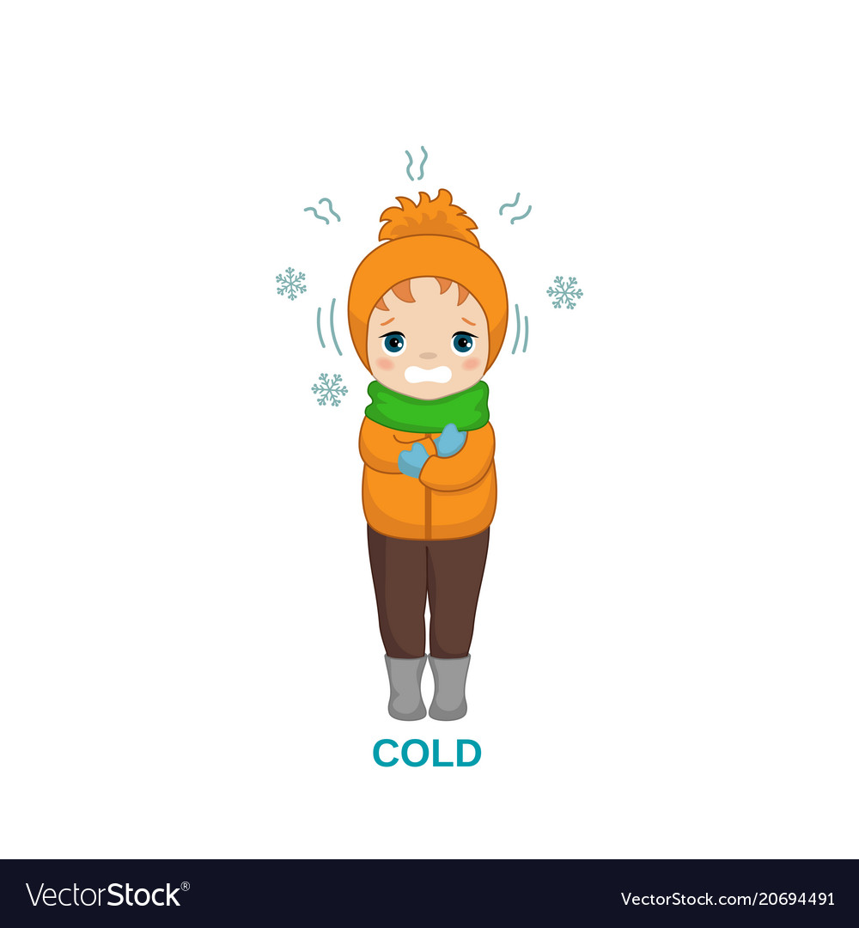
Problem : -Waking up a cold weather and keeping the room warm with low budget
Relocating from tropical Sri Lanka to colder climates presents significant challenges with heating. In my experience, a large rented room with a central heating system proved insufficient, especially during harsh winters. Traditional heating systems often fail to effectively warm larger spaces or maintain consistent comfort levels.
Current heating systems cause discomfort and increase energy costs due to the need for more external heaters. Smart heating systems offer an alternative by enabling accurate temperature control, monitoring power use, and adjusting settings based on user needs. This not only improves comfort but also helps control and lower energy costs.

Slide 3
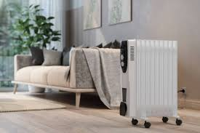
Existing methods
Kogan SmarterHome™ 7.0kW Inverter Split System Air Conditioner
Dyson Pure Hot+Cool Link Purifying Fan Heater
Goldair 2000W Smart Wi-Fi Panel Heater
Lack of full customization: Many heaters offer basic control (like on/off and scheduling), but don't allow precise temperature regulation tailored to specific room conditions or user preferences.
Limited energy monitoring: Most devices do not provide comprehensive feedback on power consumption, making it difficult for users to optimize energy usage and reduce electricity bills.
High cost for advanced features: Devices like Dyson’s Pure Hot+Cool Link offer additional features such as air purification, but come at a significantly higher price compared to other smart heaters.
Minimal user engagement: Current systems rely heavily on presets or simple automation, offering little real-time interaction or adjustments based on actual energy use or room conditions.

Slide 4
My proposed methodology (Smart home heater )
My proposed system is a budget friendly heating system that have the full customization on user’s desires .
Requirements
Hardware :
Arduino Nano 33 IoT
DHT22 Temperature and Humidity Sensor
Smart Plug with Energy Monitoring (e.g., TP-Link Kasa)
Ultrasonic Sensor
SD Card and Adapter
Other Accessories (Wires, breadboard).
Heater
Software :
Arduino IDE (for microcontroller programming)
Firebase
Mobile App Development (MIT App Inventor or Blynk)
Plotly Dash: (for data dashboard)

Slide 5
Data Collection: The Arduino captures temperature and humidity readings using a DHT22 sensor, while the ultrasonic sensor detects room occupancy.
Data Processing: This data is transmitted to a manual Python Arduino device and send to python code for processing
Storage & Visualization: The processed data is stored in a CSV file and uploaded to a Firebase database. It is also used in Plotly to generate real-time graphs, allowing users to monitor temperature variations and power usage throughout the day.
User Control via App: A dedicated app provides users access to:
Set an alarm and desired room temperature.
Monitor room occupancy.
Manually control the device
Automatically switch on the heater when the temperature falls below the preset threshold.

Slide 6

In addition to other IOT requirements, we need to set up a heater.The entire process is expected to be completed in one or two months.
Implementation of the plan
In addition to other IOT requirements, we need to set up a heater.The entire process is expected to be completed in one or two months.
This is the Gantt chart for the process
Week 1-2: Set up the basic system with the DHT22 sensor, smart plug, ultrasonic sensor and manual control from the app.
Week 3: Integrate alarm-based scheduling for automatic heating control.
Week 4: Add energy monitoring and data logging to the app, with real-time feedback on electricity usage.
Week 5: Test and optimize app performance (manual and automatic controls, energy tracking).
I estimated to complete this project around AUD 150 .

Slide 7
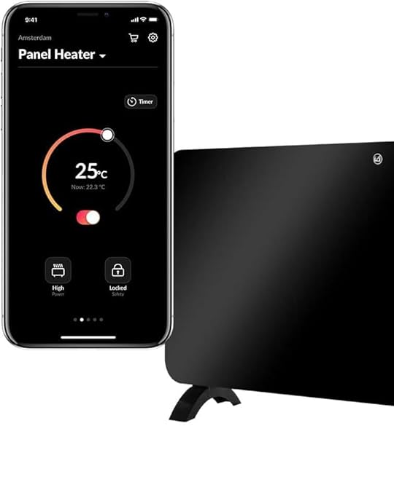
Future
Predictive Algorithms: Implementing predictive algorithms to anticipate heating needs based on historical data and user behavior, optimizing energy efficiency and user comfort.
Expanded Sensor Integration: Integrating additional sensors to monitor various environmental factors, such as occupancy, air quality, and temperature gradients, for more precise control.
Advanced Security Systems: Enhancing security features to ensure safe operation and protect against unauthorized access.

Slide 8
References
Kogan. (n.d.). Kogan SmarterHome™ 2KW Premium Glass Panel Heater – White. Kogan. https://www.kogan.com/au/buy/kogan-smarterhometm-2kw-premium-glass-panel-heater-white-kogan/
Mitre 10. (n.d.). Goldair 2000W Smart Wi-Fi Panel Heater. Mitre 10. https://www.mitre10.com.au/goldair-2000w-smart-wi-fi-panel-heater-6885685
JB Hi-Fi. (n.d.). Dyson Pure Hot+Cool Link Purifying Fan Heater – White/Silver. JB Hi-Fi. https://www.jbhifi.com.au/products/dyson-pure-hotcool-link-purifying-fan-heater-white-silver

